Slide 1
PilotBuddy
COM 437 MOBILE APPLICATION DEVELOPMENT
Three cockpit tools in one offline Android app.
Chris Gonzalez, Saint Leo University
Notes:
Introduce PilotBuddy in one sentence. It is a native Android app for student and general aviation pilots that combines a turn calculator, a wind calculator, and an airport lookup, and it works without a signal.

Slide 2
Pilots juggle too many tools
Scattered tools
Math under pressure
Weak connectivity
Calculators, charts, and airport details live in separate apps and on paper.
Switching tools costs attention, especially for students still building workload habits.
Cockpits and small airfields often have little or no signal, so cloud tools fall short.
Working problem statement, to be validated with feedback from student and general aviation pilots.
Notes:
Walk through the three pain points. Note that this is my working problem statement and I plan to test it with real pilots.

Slide 3



One app, three tools
Turn Calculator
Wind Calculator
Airport Info
Enter airspeed and bank angle to get turn rate and radius.
Enter heading and wind to get headwind and crosswind components.
Search an airport to see its runways and frequencies from a local database.
All data stays on the device, so every tool works offline.
Notes:
Each tool answers one quick question a pilot has. The calculator inputs and outputs are my current plan and may be refined during development.

Slide 4
A growing pilot population
370,286
887,519
+66%
active student pilots in the U.S. at the end of 2025
active pilots of all certificate levels
growth in student pilots since 2020, from 222,629
Source: AVweb (2026), reporting FAA U.S. Civil Airmen Statistics 2025. Growth rate calculated from the same figures.
Notes:
Student pilots are the largest single group and the clearest target audience. The 66 percent figure is my own calculation from 222,629 in 2020 and 370,286 in 2025. Full citation is on the last slide.

Slide 5
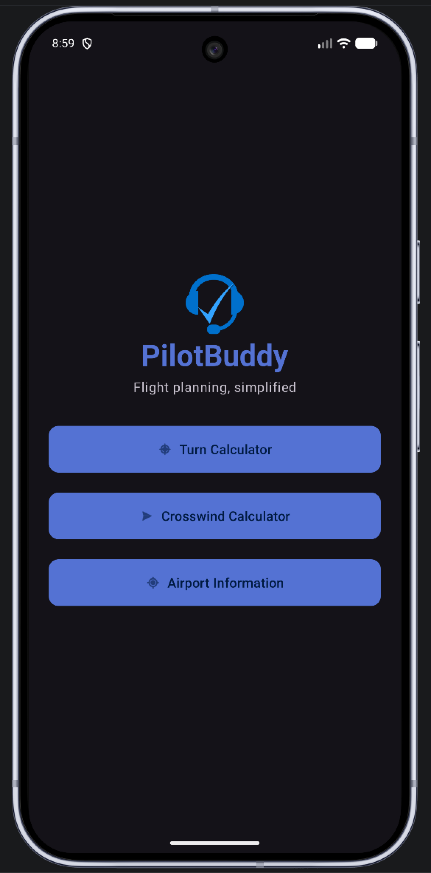
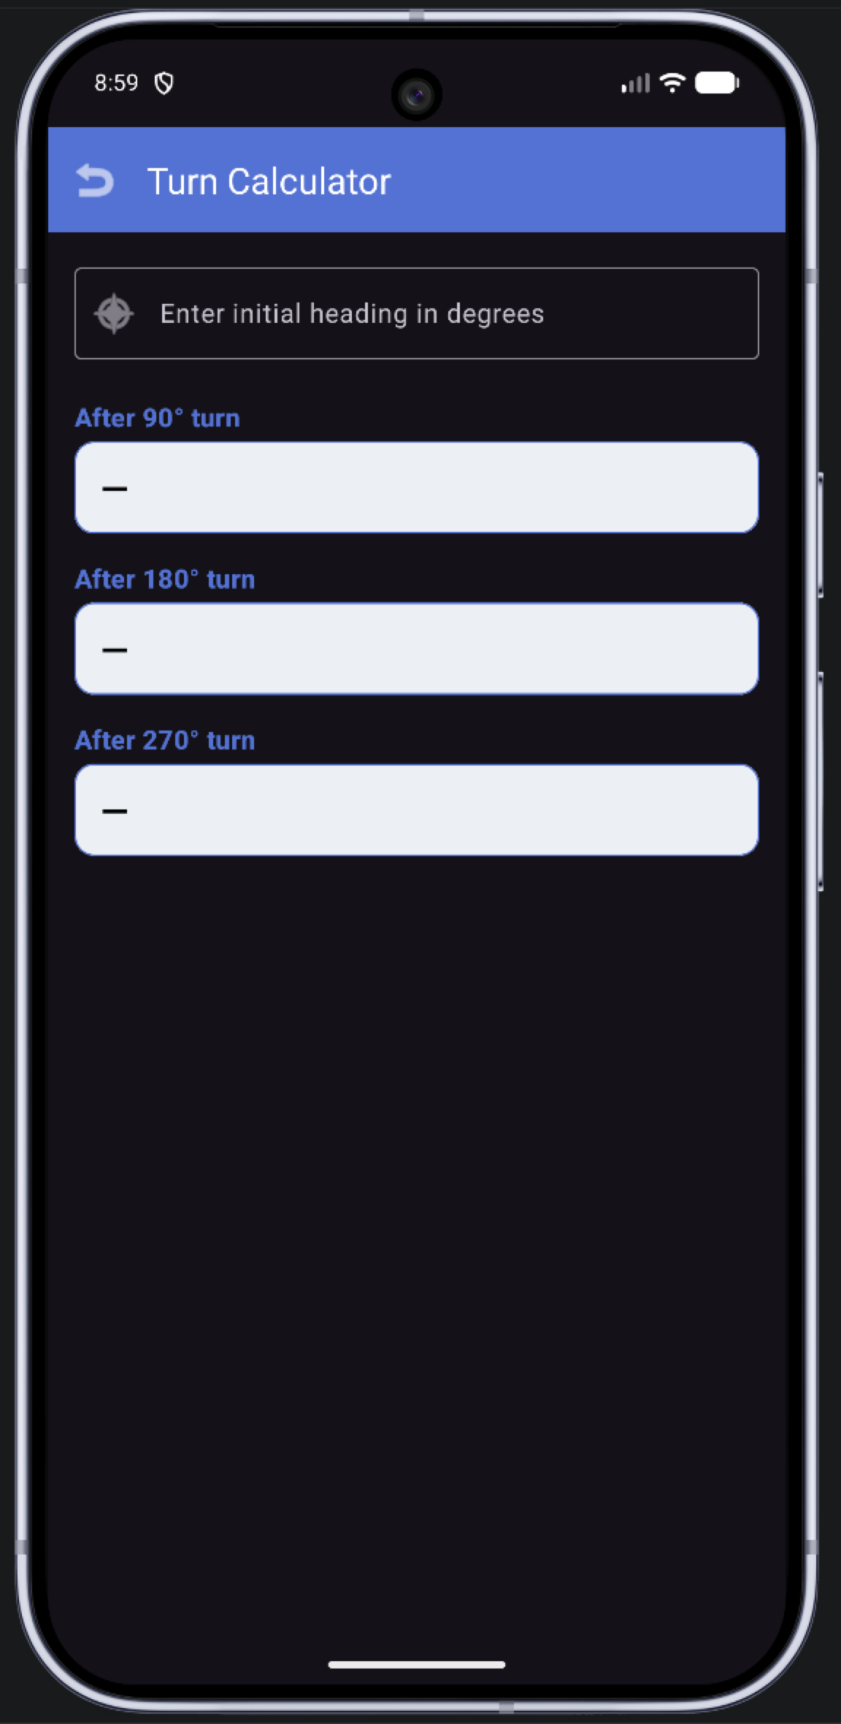
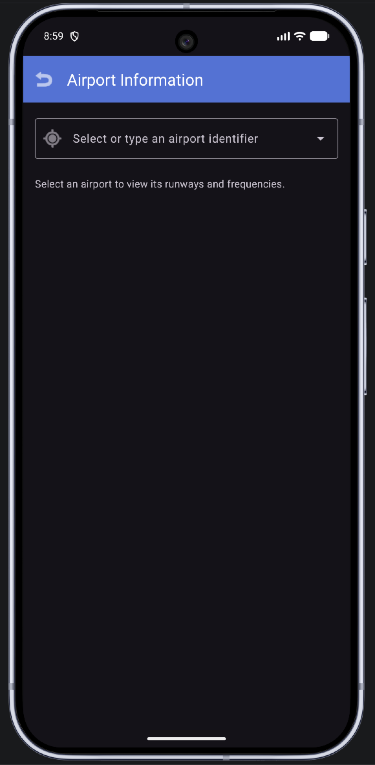
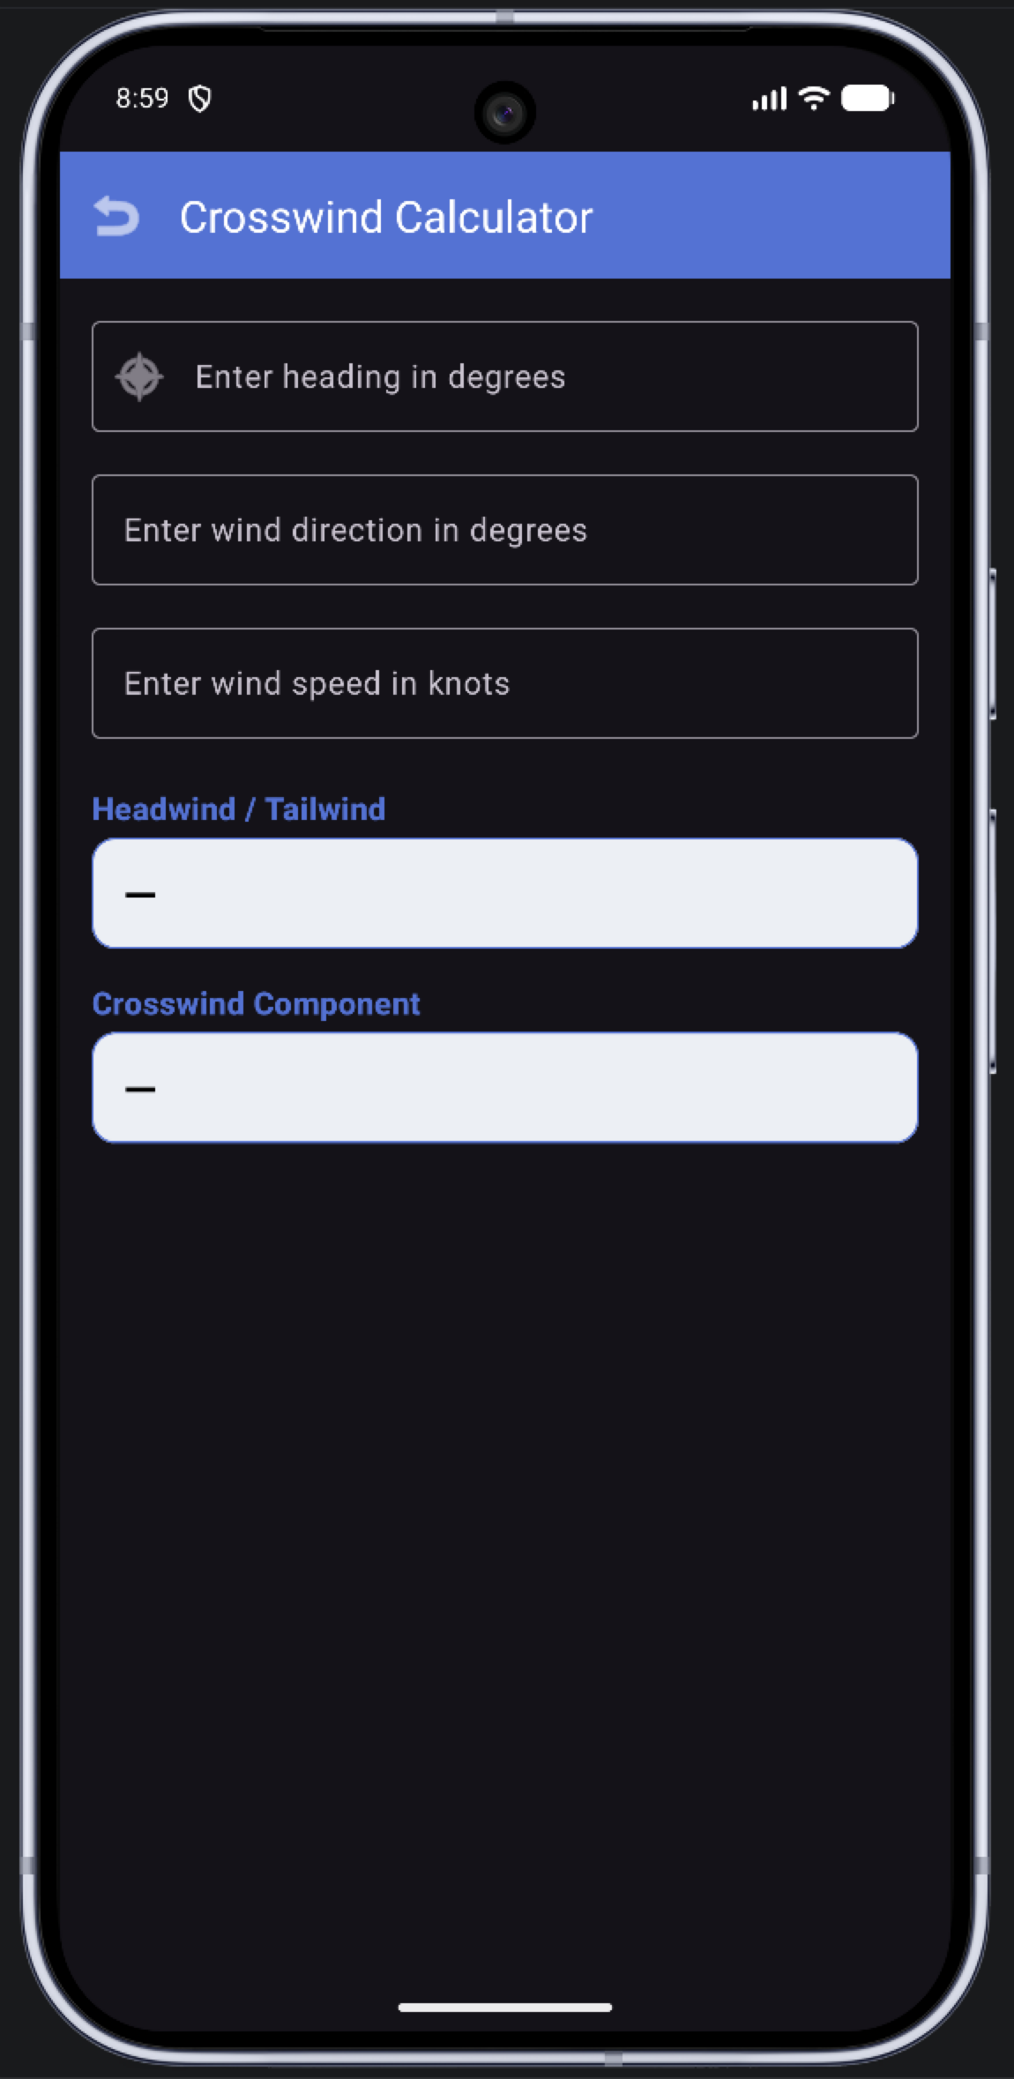
Simple screens, few taps
Notes:
Four screens: home, turn calculator, wind calculator, and airport search. Airport names here are placeholders, not real data.

Slide 6
Built to work offline
Stack
Normalized data
Native Android app in Java
Activities and XML layouts
SQLite through SQLiteOpenHelper
No server or web service needed
Table | Holds
airports | One row per airport
runways | Many per airport
frequencies | Many per airport
Proposed schema. Field names may change during implementation.
Notes:
Separate tables linked by keys avoid duplicated airport data. My background with relational databases shaped this design.

Slide 7
Help PilotBuddy reach the cockpit
NEXT STEPS
Pilot testers to try the first build
Feedback on which tools matter most
github.com/ChrisGonzalez72/PilotBuddy
Notes:
Close by asking for testers and feedback. Replace the bracketed line with a real request, or delete it.

Slide 8
References
AVweb. (2026). FAA pilot population climbs again in 2025. https://avweb.com/aviation-news/faa-pilot-population-climbs-again-in-2025/
All other slide content is original to this project.
Notes:
APA 7 references for the figures and course materials used in this deck.

